Slide 1
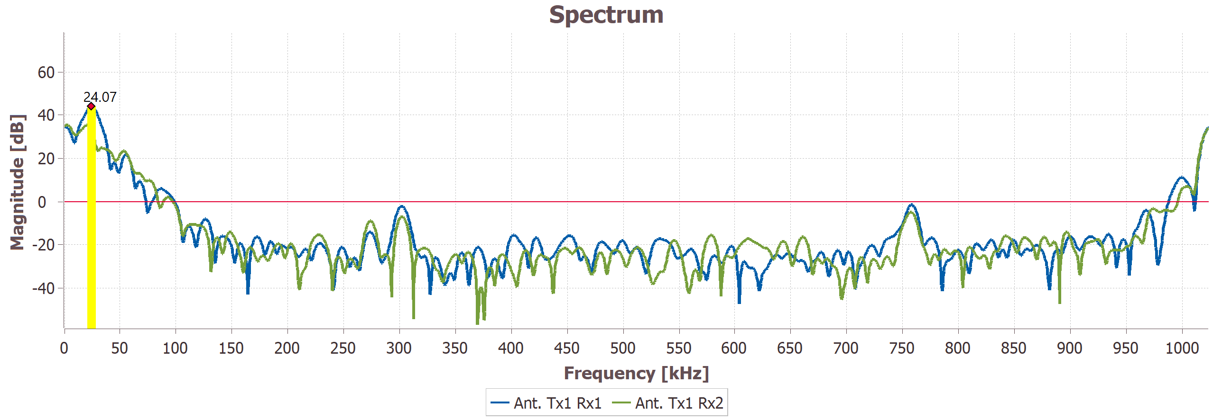
Indicates that the tag is modulating at 530 Khz, and is at a range of 43m
Peak 1: 300khz
Peak 2: 760khz
1.024 Msps sample rate (IQ), 250us upchirp time, t
How do we calculate the beat frequency tag frequency from this?
Tag is known to be modulating 287 kHz and 3.3m away (which in theory would mean 17.6 Khz beat frequency)
According to Skanda’s paper, the peaks should be at 269.4 kHz and 304.6 kHz
Fbeat = 17.6 Khz, which corresponds to range of 3.3m from fb=2RS/c

Slide 2
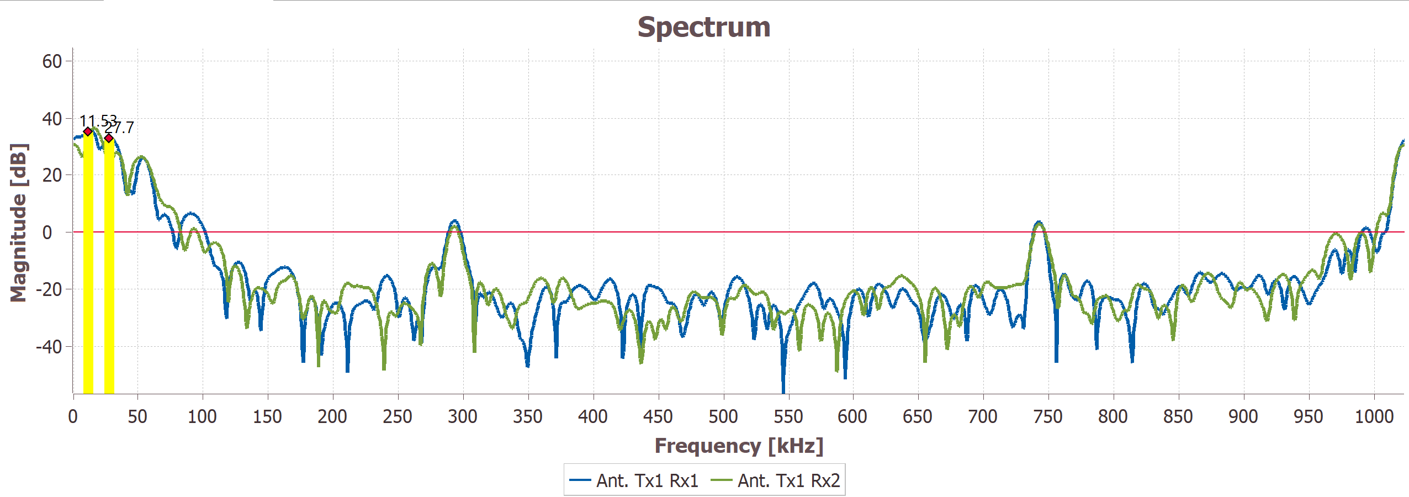
Indicate that tag is modulating at 517 kHz and is located at 42.1m
292 kHz
741 kHz
Same radar settings, but now tag at exactly 1m away from radar
Results using equations from paper inconsistent with observation.
TinyRad, with same sample rate and chirp settings has correct

Slide 3
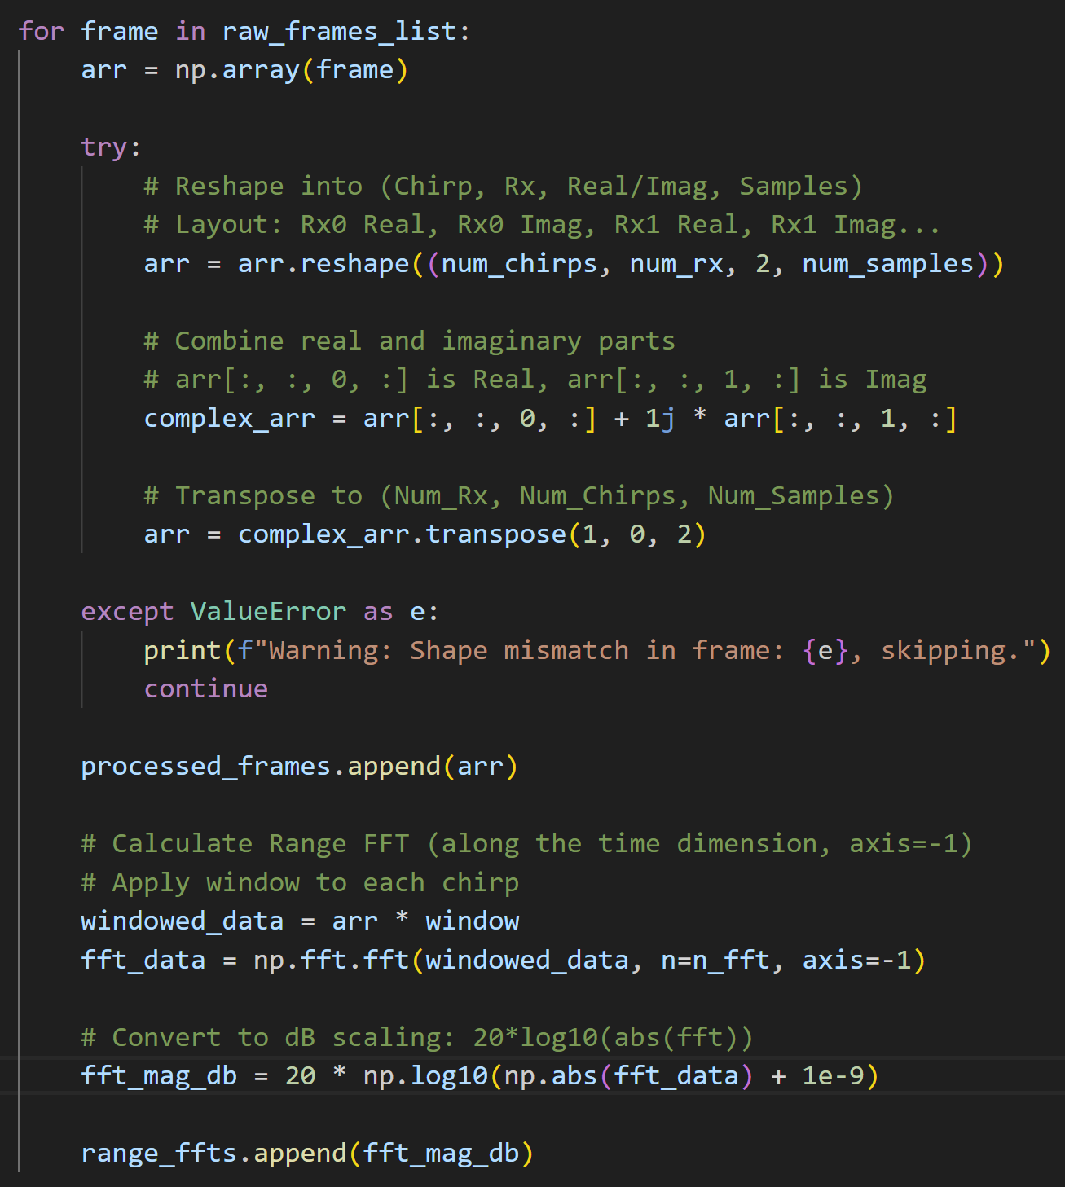
Here is the signal processing for the data.
The data is IQ for each of the 2 channels, so the first part is just formatting it so its easy to work with.
Then windowing and just a simple np.fft.fft should be all that’s necessary for relative magnitudes right?

